Slide 1
FIN 513 Case Study “CDX skew notes”
Inhyuk Lee, Wanbae Park, Yongduk Kim

Slide 2
Question 1.
Define the CDX “skew” and find how to make an arbitrage trade.
Question 2.
Design a transaction to catch CDX “skew” in CDS market and to pay bond-like cash flows.
Question 3.
What happens to my or investor’s returns if CDX ”skew” moves to more negative value?
Question 4.
Financial engineering’s overall roles and functions in financial market.

Slide 3
Question 1 : What is CDX skew?
CDX Skew note
The structured notes which repackage “the difference” between the spread of a CDS index(CDX) and its constituent single-name CDS contracts. The difference is called the Skew.
(nothing related to Skewness in Statistics)
CDX buyer takes on the credit exposure to the loans or bonds, and exposed to defaults. It means buying index is equivalent to selling protection so that buying position receive a fixed coupon.

Slide 4
Question 1 : How exactly is it calculated?
Calculation
The (Negative or Positive) Skew = Composite Spread - Model Spread
Composite Spread = a CDS index
ex) “commodity” listed on ICE named as MARKIT CDX.NA.IG.(“IG”)
Model Spread = 125 of the most liquid North American entities with investment grade credit ratings. (21st Century Fox America, Inc. AT&T Inc., CBS Corporation, HP Inc.)
The term “Spread” is price quotation and indicates basis point.
AND, the model spread is a result of converted price to quotation unit “spread”.

Slide 5
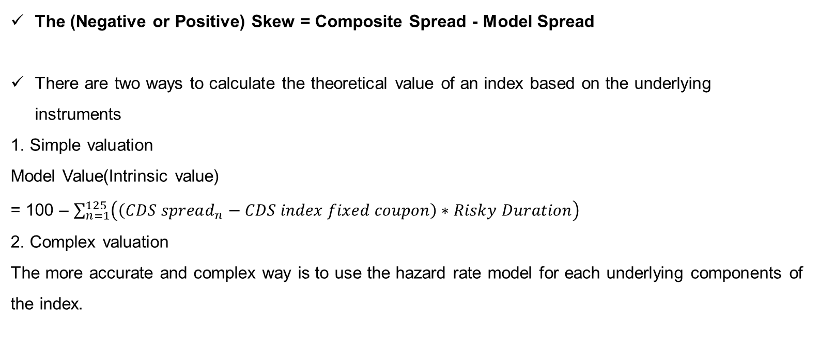
Question 1 : How exactly is it calculated?
Calculation
The (Negative or Positive) Skew = Composite Spread - Model Spread
There are two ways to calculate the theoretical value of an index based on the underlying instruments
1. Simple valuation
Model Value(Intrinsic value)
= 100 – $\sum_{n=1}^{125}{\left(\left(CDS spread_{n}−CDS index fixed coupon\right)∗Risky Duration\right)}$
2. Complex valuation
The more accurate and complex way is to use the hazard rate model for each underlying components of the index.

Slide 6
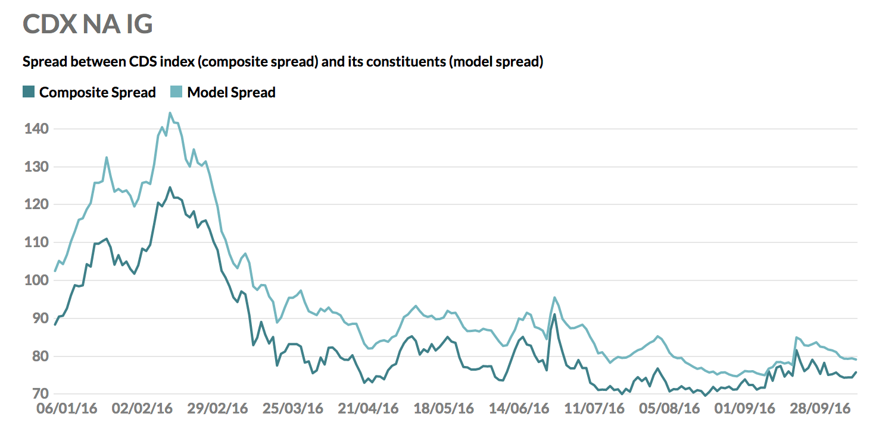
Question 1 : What arbitrage trade is available to market participants in mid 2016?
Statistical Arbitrage (Assuming convergence)
In the middle of 2016, there was negative skew. It means the composite spread is smaller than the model spread. Namely, Short the model spread(125 single-name CDS) and Long the composite spread(index) because it might generate the positive yields(model spread – composite spread >0).
Buy Cheap and Sell High!

Slide 7
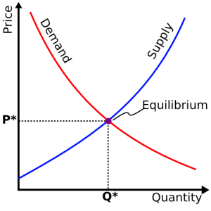
Question 1 : Who is taking the other side of this trade?
Arbitrage benefit from… Market inefficiency!
Example) Negative Skew Case
1) Model spread
Demand : A lot of Single name protection buyer
Supply : Small number of Single name protection seller
2) Composite spread
Demand : Small number of CDX long position
Supply : A lot of CDX short position
Why did negative skew happened?
In 2016, illiquidity of corporate bond market was severe and needs for protection went to CDX market.
But!, it can be the opposite anytime depending on the economic circumstances

Slide 8
Question 2
Suppose you work for a bank and want to take advantage of the opportunity to issue a skew bond. Assume the “skew” is -15 bp when the transaction is initiated. (1) How to design a transaction that can pay investors LIBOR + 2.00% with certainty? Design a transaction that can pay investors LIBOR + 200 bp with certainty.
(2) Explain the terms of the deal and what trades your bank needs to undertake to set up the note, and to guarantee that investor’s principal is protected. (3) Show a diagram of where all the cash-flows go in your structure.
Investors
BANK
CDS Market
?
?
LIBOR + 2.00%
per anuum
- 0.15% (Skew)
We NEED six steps to do ! Let’s look a example of Citibank’s Skew note.

Slide 9
Question 2 : Big Picture
< STEP 4 >
Interest Rates Swap
Initial Exchange Amount
= Purchase price of Lloyd Bank’s Notes – CDX Skew Notes
LIBOR + 2.00%
per annum
(quarterly)
SELL
Skew note
< STEP 2 >
LIBOR + 2.00% per annum
(quarterly)
CDX Skew note
investor
Dublin,
Ireland
Libretto Capital
London,
U.K.
Citibank London
Branch
< STEP 1 >
CDX Skew
Arbitrage Strategy
(Long-Short Position)
Principal
USD 10,000,000
2.70% per annum
(quarterly)
BUY Skew note
< STEP 5 >
BUY CHEAP
CDX.NA.HY24
(CDS Index)
Protection Seller
Total Return Swap
Original Notional Amount: USD 150,000,000(15x)
(CDS Index)
LONG
Composite Spread
(Market Price)
CDS Index Return
CDS Market
5.00% per annum (quarterly)
< STEP 6 >
SHORT
Model Spread
(Intrinsic Price)
SELL HIGH
Reference Entity CDS
(Single Names CDS)
Protection Seller
Total Return Swap
Original Notional Amount: USD 150,000,000(15x)
(CDS Index Multiple Single Names CDS)
5.00% per annum (quarterly)
BUY Lloyd
Bank’ Notes
Multiple Single Names CDS Portfolio Return
< STEP 3 >
2.70%
per annum
(semi-annual)
Principal
USD
10,000,000
: Transactions
SELL Lloyd
Bank’ Notes
Lloyd
Bank
: Entities
: Swap contracts
: Floating cash flows
: Fixed cash flows

Slide 10

Question 2 : Back to 2016
1. Structural reform of the EU banking sector
The European Commission proposed a regulation to stop the largest and most complex banks from engaging in the risky activity of proprietary trading.
2. The Solvency II regime will become fully applicable on 1 January 2016
Capital requirements including the solvency capital requirements (SCR) and the minimum capital requirements (MCR) are strengthened.
3. Negative Interest rates
Negative government bonds yields makes European insurance companies to choose other investable assets.
Source : ECB statics

Slide 11
Step 1. CDS market side
In 2016 CDS market, there were arbitrage opportunities.
Index spread was lower than its components portfolio spread.
If we expect two prices will converge ? Buy Cheap and Sell High!
London,
U.K.
Citibank
London
Branch
CDX Skew
Arbitrage Strategy
(Long-Short Position)
BUY CHEAP
CDX.NA.HY24
(CDS Index)
Protection Seller
LONG
Composite Spread
(Market Price)
CDS Market
SHORT
Model Spread
(Intrinsic Price)
SELL HIGH
Reference Entity CDS
(Single Names CDS)
Protection Seller
However, risky activity of proprietary trading was banned.

Slide 12
Step 2. Investor side
In 2016 European government bonds market, it was not favorable for fixed-income security investors.
As we seen before, government bonds yields were negative at least to eight years maturity.
Long-term investors such as insurance companies pursued positive yield products.
London,
U.K.
Citibank
London
Branch
Negative Yields
Positive Yields
Bond Market
Investors
(European Insurance
Companies)
Principal
USD 10,000,000
Principal
USD 10,000,000
Therefore, investors asked banks to construct a new product with positive yield and bond-like characteristics.

Slide 13
Step 2. Both sides
What if the bank issue a fixed income product, named “Skew Note” with LIBOR + 2.00% coupon rates ?
It solves one of investors’ needs. (positive yields)
It also gives a justification for the bank to trade CDX skew arbitrage transactions, which may not be classified as a proprietary trading because this Long-Short position’s purpose are connected to client activity.
London,
U.K.
Citibank
London
Branch
CDX Skew
Arbitrage Strategy
(Long-Short Position)
BUY CHEAP
CDX.NA.HY24
(CDS Index)
Protection Seller
LIBOR+ 2.00%
per annum
(quarterly)
LONG
Composite Spread
(Market Price)
Investors
(European Insurance
Companies)
CDS Market
Principal
USD 10,000,000
SHORT
Model Spread
(Intrinsic Price)
SELL HIGH
Reference Entity CDS
(Single Names CDS)
Protection Seller
However, we have two questions.
Is it possible for the bank certainly to pay the coupon ?
And to protect the investor’s principal ?

Slide 14
Step 3. Both sides + third party
In the mid of 2016, there was a bank to issue a mid-term notes with 2.70% coupon rates.
Lloyd Bank’s mid-term unsecured senior debt ratings of “A1” by Moody's, “A” by S&P and “A+” by Fitch in 2016.
SELL
Skew note
CDX Skew
Arbitrage Strategy
(Long-Short Position)
BUY CHEAP
CDX.NA.HY24
(CDS Index)
Protection Seller
London,
U.K.
Citibank
London
Branch
BUY Skew note
LIBOR+ 2.00%
per annum
(quarterly)
LONG
Composite Spread
(Market Price)
Investors
(European Insurance
Companies)
CDS Market
Principal
USD 10,000,000
SHORT
Model Spread
(Intrinsic Price)
SELL HIGH
Reference Entity CDS
(Single Names CDS)
Protection Seller
BUY Lloyd
Bank’ Notes
2.70%
per annum
(semi-annual)
Principal
USD
10,000,000
SELL Lloyd
Bank’ Notes
Lloyd
Bank
Now, it has high likelihood to guarantee the investor’s principal.
And plus fixed cash flows.

Slide 15
Additional benefit (Tax and Risk)
In 2016, U.K. corporate tax rate was 19.00%, however, Ireland corporate tax rate was 12.50%.
Furthermore, if the bank hopes to insulate CDX skew arbitrage trading’s risks ?
Found a special purpose vehicle(SPV).
Where? not in London, but in Ireland for tax benefits.
And sign several swap contracts to move earnings and risks from the bank to SPV.
Source : OECD statics

Slide 16
Step 4, 5, 6. Found SPV and Sign several swap contracts
Several Swap Contracts
SELL
Skew note
CDX Skew
Arbitrage Strategy
(Long-Short Position)
LIBOR+ 2.00% per annum
(quarterly
Tax rates
19.00%
London,
U.K.
Citibank
London
Branch
Tax rates
12.50%
Dublin,
Ireland
Libretto Capital
LONG
Composite Spread
(Market Price)
BUY CHEAP
CDX.NA.HY24
(CDS Index)
Protection Seller
BUY Skew note
LIBOR+ 2.00%
per annum
(quarterly)
2.70% per annum
(semi-annual)
Investors
(European Insurance
Companies)
CDS Index Return
CDS Market
SHORT
Model Spread
(Intrinsic Price)
Principal
USD 10,000,000
5.00% per annum (quarterly)
5.00% per annum (quarterly)
SELL HIGH
Reference Entity CDS
(Single Names CDS)
Protection Seller
BUY Lloyd
Bank’ Notes
Multiple Single Names CDS Portfolio Return
2.70%
per annum
(semi-annual)
Principal
USD
10,000,000
SELL Lloyd
Bank’ Notes
Lloyd
Bank
Now, a combination of transactions satisfy all participants except…
The tax receiver, namely the government !

Slide 17
Question 2 : Revisited Big Picture
< STEP 4 >
Interest Rates Swap
Initial Exchange Amount
= Purchase price of Lloyd Bank’s Notes – CDX Skew Notes
LIBOR + 2.00%
per annum
(quarterly)
SELL
Skew note
< STEP 2 >
Dublin,
Ireland
Libretto Capital
LIBOR + 2.00% per annum
(quarterly)
CDX Skew note
investor
London,
U.K.
Citibank London
Branch
< STEP 1 >
CDX Skew
Arbitrage Strategy
(Long-Short Position)
Principal
USD 10,000,000
2.70% per annum
(quarterly)
BUY Skew note
< STEP 5 >
BUY CHEAP
CDX.NA.HY24
(CDS Index)
Protection Seller
Total Return Swap
Original Notional Amount: USD 150,000,000(15x)
(CDS Index)
LONG
Composite Spread
(Market Price)
CDS Index Return
CDS Market
5.00% per annum (quarterly)
< STEP 6 >
SHORT
Model Spread
(Intrinsic Price)
SELL HIGH
Reference Entity CDS
(Single Names CDS)
Protection Seller
Total Return Swap
Original Notional Amount: USD 150,000,000(15x)
(CDS Index Multiple Single Names CDS)
5.00% per annum (quarterly)
BUY Lloyd
Bank’ Notes
Multiple Single Names CDS Portfolio Return
< STEP 3 >
2.70%
per annum
(semi-annual)
Principal
USD
10,000,000
: Transactions
SELL Lloyd
Bank’ Notes
Lloyd
Bank
: Entities
: Swap contracts
: Floating cash flows
: Fixed cash flows

Slide 18
Question 3: What happens the skew gets more negative?
SKEW = Composite Spread – Model Spread
More negative skew: Larger difference between composite spread and model spread
Composite Spread
Marked to Market
Model Spread
NOT Marked to Market

Slide 19
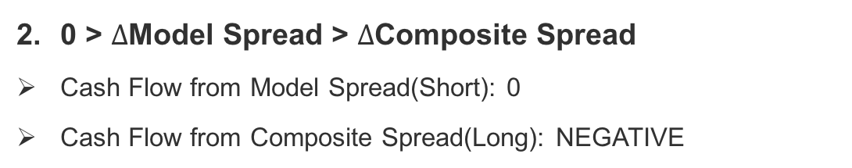
Question 3: Two Cases for Negative Skew
Skew gets more negative means change in model spread is larger than change in composite spread.
We can separate it into two cases.
$∆$Model Spread > $∆$Composite Spread > 0
Cash Flow from Model Spread(Short): 0
Cash Flow from Composite Spread(Long): Positive
0 > $∆$Model Spread > $∆$Composite Spread
Cash Flow from Model Spread(Short): 0
Cash Flow from Composite Spread(Long): NEGATIVE
Model Spread
Composite Spread
Composite Spread ONLY affects intermediate cash flow.

Slide 20
Question 3: Marking-to-Market Problem – Needs for additional cash
If the skew diverges, there will be negative return to the bank.
The bank has to pay in additional cash because of negative return at terminal date of strategy.
However, sometimes, the bank should pay in additional cash in intermediate period even if the skew converges to zero…
This is because value of long position is not offset by short position.
Composite spread: marked-to-market / model spread: non-marked-to-market.
Higher leverage would make it worse: higher initial margin, higher maintenance margin…
How can overcome this caveat?
If the bank can make marking-to-market value of short position by dynamically trading their short position, marking-to-market value from long position might be offset.
Is it possible to make marking-to-market value manually?
I don’t know. Maybe not. It depends on market condition.

Slide 21
Question 3: How does this affect risk/reward characteristics?
Marking-to-market feature has considerable impacts on risk/reward characteristics of the transaction.
It increases notes issuer’s credit risk.
The issuer must be ready to fulfill margin.
Cash flow are not matched between long and short position.
Assume: Selling order for CDS index increases dramatically.
Long position value will immediately and rapidly decrease.
The bank should have sufficient funds to hold its long position.
However, there is no offset cash flow from short position because model spread is not marked-to-market.
Possibility of default due to lack of cash.

Slide 22
Question 4: What financial engineering problem skew bond solve?
First, what is the “financial engineering problem”?
From the lecture note:
Financial engineers create, analyze, and trade derivative products.
Derivatives get around market imperfections.
Financial engineering is kind of dealing with market imperfection.
Q. How the skew note deals with market imperfections?

Slide 23
Question 4: What financial engineering problem skew bond solve?
Market Imperfection
Corporate Tax
Difference
Regulation
Investor:
Solvency II
Issuer:
Prop-trading
Swaps:
Transfer Return
Skew Note
Embedded
Trading
More efficient market, more profitable firm

Slide 24
THANK YOU!

